Slide 1
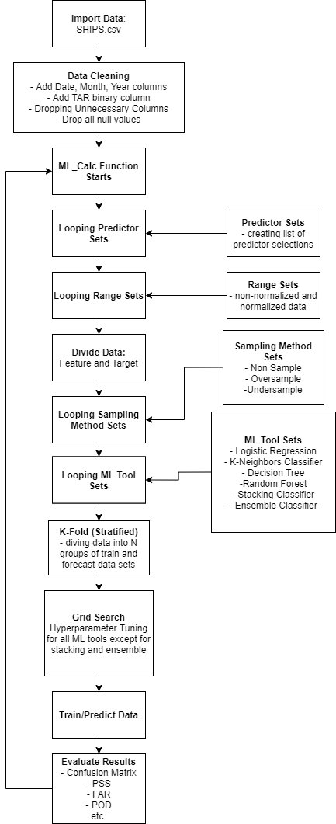
Updates to the Prediction Model
Updated To Be Regressor (Previously Classifier)
New Data Set – w/o precipitation
New Data Cleaning Process
Ensemble Regressor Fixed

Slide 2
New Data Set – w/o precipitation
Before: Recent SHIPS dataset with precipitation data
After: Overall SHIPS dataset from 1982 (added Month and Latitude as feature set)
Result: Doubled amount of rows leading to more accurate results

Slide 3
New Data Cleaning Process
Before : Drop all rows with null values without pre-processing (~7000 rows remaining)
After: Replace null values with average values (11782 rows remaining)
Result: Decreased RMS error by having more data

Slide 4
Ensemble Regressor Fixed
Before: Had trouble implementing Raksha’s ensemble class to regression model
After: Debugged the function
Result: Ensemble model can be used to predict DELV24

Slide 5
Current Approach
Dataset: SHIPS_Historical
Data Cleaning Method: Drop All Nulls, Replace Nulls with Avg
Data Scaling: Normalized/Non-Normalized
Feature Set: Set1, Kaplan_Improved (Months and Latitude included)
Model Set: Ensemble, K-Mean, Decision Tree, Linear Reg, Random Forest

Slide 6
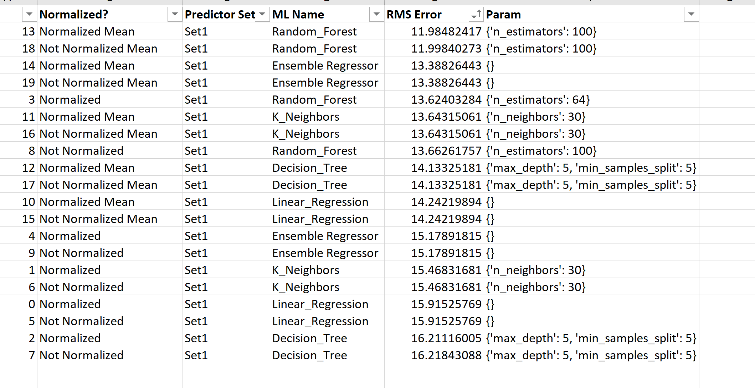
Results
The goals is to beat 10 RMS Error when predicting DELV24
Updated :
With the update, RMS Error decreased from ~16 to ~12.

Slide 7
Next Steps
Use wind-speed in 24 hours as target
Plot RMS by year to see if there is any trend
Hyperparameter Optimization
Currently, a rigorous hyperparameter tuning process wasn’t implemented to save time
Ensemble Model Optimization
Use tuned hyperparameter as the input
Try multiple ensemble method: average, max, mode, etc.
Try multiple ensemble weight distribution
Implement New ML Algorithms
Try different methods to clean null values

